Slide 1
E-Commerce Website(Phone Store)
PIP104 University Project-II
Review-1
Batch Number:183
Roll Number | Student Name
20211CSE0123 | Rayapu Reddy Ruchitha
20211CSE0151 | S.Saraswathi Sree Moulya
20211CSE0130 | Depatla Ganesh Reddy
20211CSE0012 | Gandla Siva Sai krishna
Under the Supervision of,
Mr. Taranath
Dr. / Mr. / Ms.
Professor / Associate Professor / Assistant Professor
School of Computer Science & Engineering
Presidency University

Slide 2
Introduction
The Phone Store E-Commerce Website is a project designed to create an online platform similar to Amazon and Flipkart, dedicated to selling mobile phones. The website will feature various types of phones, their prices, and key specifications, alongside a user-friendly interface with a header, footer, and navigation bar. The website will also offer customer support functionality. The project aims to simplify the online phone purchasing experience, provide detailed comparisons, and support users with clear and concise information.

Slide 3
Literature Review
In the development of e-commerce websites for selling mobile phones, we examined several existing platforms to understand their strengths and weaknesses. Below are the advantages and limitations of each platform related to our project:
Amazon
Advantages:
Established trust and reputation.
Offers a vast range of products, including mobile phones, with detailed product descriptions.
Easy-to-use navigation and comprehensive customer reviews.
Disadvantages:
The interface can be overwhelming due to the vast number of categories and products.
Not focused solely on mobile phones, so it lacks specialization.
Prices fluctuate frequently, causing inconsistency.

Slide 4
Literature Review
Flipkart
Advantages:
Strong presence in the Indian market, with region-specific promotions and offers.
Provides detailed filtering options for mobile phones by brand, price, and specifications.
Disadvantages:
Like Amazon, it lacks specialization in mobile phones.
The design is cluttered with ads and promotions that may distract users from making informed purchases.

Slide 5
Literature Review
Snapdeal
Advantages:
Competitive pricing and good offers on mobile phones.
Easy to navigate on mobile devices.
Disadvantages:
Outdated user interface.
Limited after-sales service and fewer reviews, reducing customer trust.
Myntra (Tech Section)
Advantages:
Known for its aesthetic design and easy-to-use mobile app.
Offers a smooth, visually appealing shopping experience.

Slide 6
Literature Review
Disadvantages:
Primarily focused on fashion, and its technology section is small and less detailed.
Limited variety of mobile phones compared to other platforms.
Advantages:
Integrated with Paytm payment gateway, making transactions seamless and easy.
Offers cashback and discounts frequently on mobile phones.
Disadvantages:
Interface cluttered with banners and promotional offers.
Poor customer service and support for product issues.

Slide 7
Literature Review
Croma Online
Advantages:
Focuses specifically on electronics, including a wide range of mobile phones.
In-store pickup options and assistance available through physical outlets.
Disadvantages:
Less competitive pricing compared to Amazon or Flipkart.
Limited number of customer reviews compared to bigger platforms.
Reliance Digital
Advantages:
Strong integration with Reliance Jio services and offers.
A good selection of mobile phones, especially popular brands.
Disadvantages:
The website is often slow, with outdated designs.
Limited after-sales support online.

Slide 8
Objectives
1.To develop a specialized e-commerce platform dedicated solely to mobile phones, ensuring that users can easily find and compare various mobile phone models without the distractions of unrelated product categories.
2.To implement a clean and intuitive user interface that simplifies the mobile shopping experience, addressing the common issue of cluttered designs found on larger e-commerce websites.
3.To offer detailed mobile phone specifications and price comparisons to enable users to make well-informed purchasing decisions based on features, customer reviews, and cost.
4.To integrate seamless customer support through live chatbots or inquiry forms, ensuring that users receive prompt assistance during their browsing or purchasing process, enhancing the overall customer experience.

Slide 9
Methodology
Software and Technologies Used:
Frontend: HTML, CSS, JavaScript
Backend: Python, Django
Database: MySQL
Version Control: Git and GitHub
Development Environment: Visual Studio Code
Customer Support: Chatbots and contact forms via APIs
Design Procedure:
User Interface Design: The website layout will include a header with categories, a footer with links, and a navigation bar for easy access to different sections.
Product Listing: Each mobile phone will be listed with an image, price, and specifications, allowing users to compare options easily.

Slide 10
Methodology
Shopping Cart and Checkout: Users can add phones to a shopping cart and proceed to checkout securely.
Customer Support: Integrated chatbots for live assistance and a form for inquiries.

Slide 11
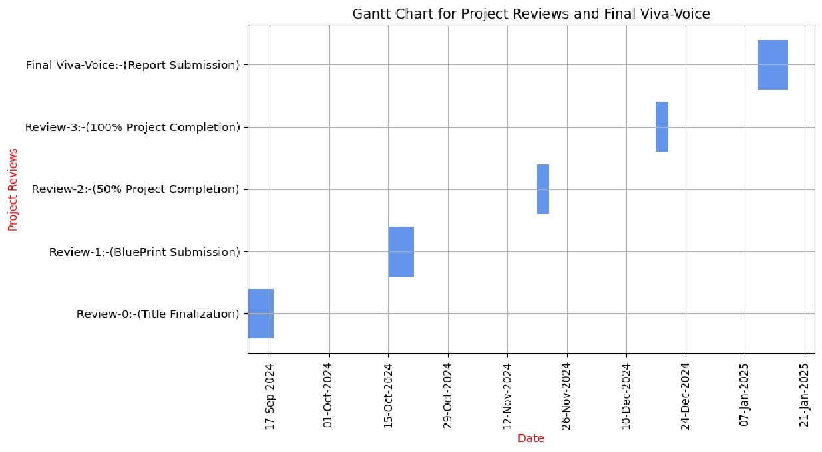
Timeline of Project

Slide 12
Expected Outcomes
1 A specialized and user-friendly e-commerce platform exclusively for mobile phones, allowing customers to easily browse, compare, and purchase mobile phones from various brands with clear and detailed product descriptions.
2 A clean, intuitive, and responsive user interface that offers a seamless experience across both desktop and mobile devices, addressing the cluttered designs found in existing multi-category e-commerce platforms.
3 Comprehensive filtering and comparison features that enable users to sort mobile phones by price, specifications, and brand, simplifying the decision-making process.
4 Efficient customer support system integrated via live chatbots and inquiry forms, ensuring that users can quickly receive help or clarification during their shopping experience, improving overall customer satisfaction.

Slide 13
Expected Outcomes
5 A scalable and maintainable platform capable of handling an increasing number of users and mobile phone listings, with regular updates and enhancements based on customer feedback.
6 Improved customer experience compared to existing platforms like Amazon and Flipkart by focusing specifically on mobile phones, removing unnecessary distractions, and offering a smoother, more focused shopping journey.

Slide 14
Conclusion
The Phone Store E-Commerce Website aims to provide a streamlined and user-friendly platform specifically designed for mobile phone sales. By focusing on mobile phones alone, the platform addresses the shortcomings of major e-commerce websites, which tend to offer a cluttered and overwhelming experience due to their broad product ranges.
Through careful design, the project ensures an intuitive interface that simplifies product comparison and purchase decisions. The detailed listings of mobile phone specifications, coupled with price comparisons and customer support, will offer users a specialized and efficient shopping experience.
By integrating live chatbots and inquiry forms, the platform also ensures that customers receive timely assistance, further enhancing customer satisfaction. In conclusion, this project fills a vital gap in the current e-commerce landscape by offering a dedicated mobile phone marketplace that prioritizes ease of use, transparency, and customer support, setting a new standard for niche e-commerce platforms.

Slide 15
References
Amazon - Official website: https://www.amazon.com Analyzed for user interface, navigation, and mobile phone product listings.
Flipkart - Official website: https://www.flipkart.com Reviewed for region-specific offers, filtering options for mobile phones, and user experience.
Snapdeal - Official website: https://www.snapdeal.com Studied for pricing strategies, mobile-friendly navigation, and customer support limitations.
Myntra (Tech Section) - Official website: https://www.myntra.com Examined for its aesthetic design, app experience, and limitations in the technology section.
Research articles and case studies on e-commerce user experience design and customer support integration.

Slide 16
Thank You

